Slide 1

Pharmaceutical Industry

Slide 2

What is Pharmaceutical Industry?
The pharmaceutical industry refers to the sector of the economy that is involved in the research, development, production, and marketing of pharmaceutical drugs. This industry plays a crucial role in the discovery and manufacturing of medications that are used for the prevention, treatment, and management of various medical conditions.

Slide 3

Why we need Pharmaceutical Industry?
Drug Discovery and Development
Disease Prevention and Control
Treatment of Medical Conditions
Innovation and Advancements in Medicine
Economic Contribution
Global Health Challenges
Improving Life Expectancy

Slide 4

Types of pharmaceutical industry
Pharmaceutical Manufacturing
Biopharmaceuticals/Biotechnology
Generic Pharmaceuticals
Over-the-Counter (OTC) Pharmaceuticals
Contract Manufacturing and Research Organizations (CMO/CRO)
Specialty Pharmaceuticals
Pharmaceutical Distribution
Pharmaceutical Services and Consulting
Animal Health Pharmaceuticals
Pharmaceutical Research and Development (R&D)
Pharmaceutical Marketing and Sales

Slide 5

Trends in pharmaceutical industry
Accelerate using AI and analytics
Continued dominance of small molecule drugs
Increasing adoption of biologics
Growing demand for personalized medicine
Increasing R&D costs
Supply chain management

Slide 6


Slide 7
Pfizer Inc. is an American multinational pharmaceutical and biotechnology corporation headquartered at The Spiral in Manhattan, New York City. The company was established in 1849 in New York by two German entrepreneurs, Charles Pfizer and his cousin Charles F. Erhart.

Slide 8
What is Pfizer known for?
Pfizer has developed some of the world’s most impactful medicines and vaccines, including a best-selling over-the-counter pain reliever, a popular medicine for anxiety and panic disorder management, an erectile dysfunction treatment, a vaccine to help provide protection against COVID-19, and an oral COVID-19 prescription treatment for patients at high risk of progressing to severe COVID-19.

Slide 9
Pfizer’s mission and vision is better known as Pfizer’s purpose, which is Breakthroughs That Change Patients’ Lives.

Slide 10
Well known drugs of Pfizer
Nexium24HROver-the-counter heartburn drug
Prevnar 13Vaccine to prevent pneumonia
AdvilNon-steroidal anti-inflammatory drug (pain reliever)
ViagraErectile dysfunction drug
Xanax Psychoactive medicine
ZoloftSSRI antidepressant
ChantixSmoking cessation drug

Slide 11

Revenue
Pfizer annual/quarterly revenue history and growth rate from 2019 to 2023.
Pfizer revenue for the quarter ending September 30, 2023 was $13.232B, a 41.55% decline year-over-year.
Pfizer revenue for the twelve months ending September 30, 2023 was $68.537B, a 31.38% decline year-over-year.
Pfizer annual revenue for 2022 was $100.33B, a 23.43% increase from 2021.
Pfizer annual revenue for 2021 was $81.288B, a 95.16% increase from 2020.
Pfizer annual revenue for 2020 was $41.651B, a 1.82% increase from 2019.

Slide 12
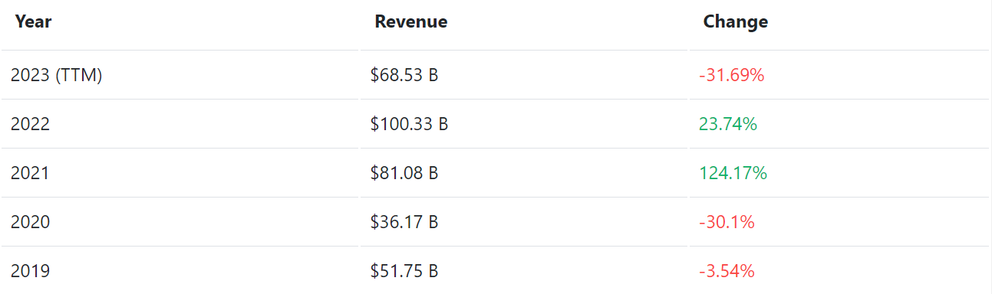
Annual Revenue

Slide 13
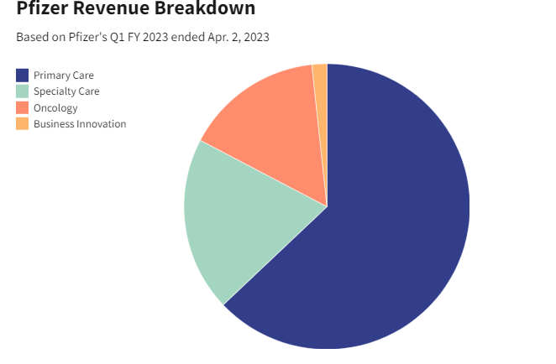

Slide 14
Exploring Pfizer's Contributions:
Breakthrough Medicines: Pfizer has been at the forefront of developing groundbreaking medicines, addressing a wide spectrum of health challenges.
Global Reach: With a presence in over 150 countries, Pfizer's impact on global healthcare is profound, bringing quality treatments to diverse communities.
COVID-19 Response: A pivotal player in the fight against the pandemic, Pfizer, in collaboration with BioNTech, developed a pioneering COVID-19 vaccine, demonstrating commitment to global health.
Research Excellence: Pfizer's commitment to research and development continues to drive innovation, pushing the boundaries of science to improve and extend lives.

Slide 15
Looking Ahead:
As Pfizer continues to evolve, the company remains steadfast in its mission to be a premier bio pharmaceutical innovator, shaping the future of healthcare.

Slide 16
Thank you !

